Slide 1
The Reporting System—The Basics
Training Module
Copyright © 2022 Cambium Assessment, Inc. All rights reserved.
Notes:
Welcome to this mini training module on the basics of the Reporting system.
This training module is based on the Reporting System User Guide for Summative and Interim Assessments, which is available on your assessment portal. This presentation includes sample screenshots. Some images may differ slightly from your state system.

Slide 2
Topics in Order of Presentation
Log in to Reporting & Understand User Roles
Dashboard Generator Page & the Dashboard
Performance on Tests Report
District, School, Teacher, and Student Reports
Print and Export Data
Generate Individual Student Reports (ISRs) & Student Data Files
Use the Longitudinal Report and the Demographic Breakdown Report
Change Reporting Time Period
Notes:
This module covers the basics of the Reporting system. The topics covered are general tasks like logging in and navigating from the dashboard generator through the subsequent reports for district and school users and teachers. Topics then include printing and exporting data and generating ISRs and student data files. Two unique reports are covered: the Longitudinal Report and the Demographic Breakdown Report. The module concludes with an explanation of how to view results from previous school years and students by using the Change Reporting Time Period function.

Slide 3
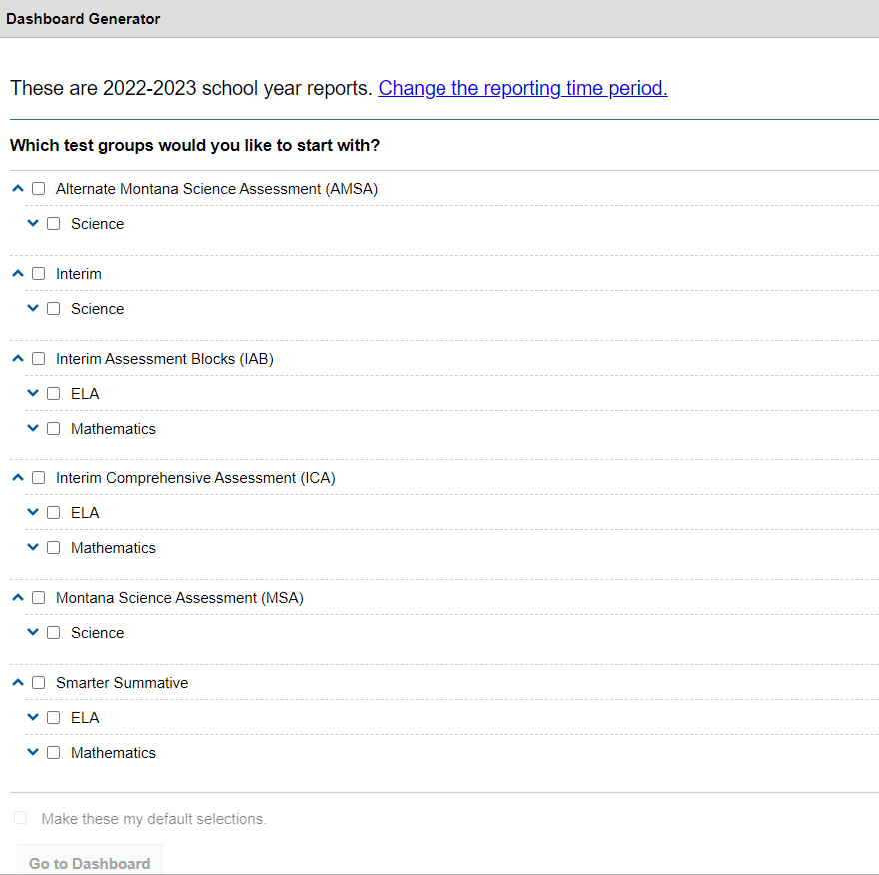
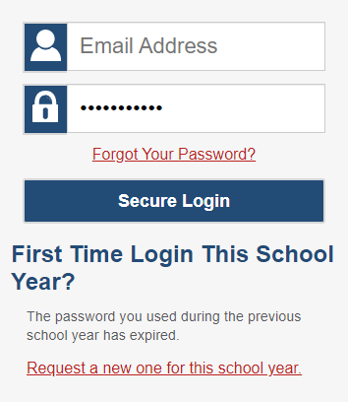
Log In to Reporting
Notes:
To log in to Reporting, go to your portal. Select the appropriate assessment card and the Reporting System card. Enter the email address associated with your Test Information Distribution Engine (TIDE) account and your password. Then select Secure Login. The display will be the Dashboard Generator where you can make selections by assessment program.

Slide 4
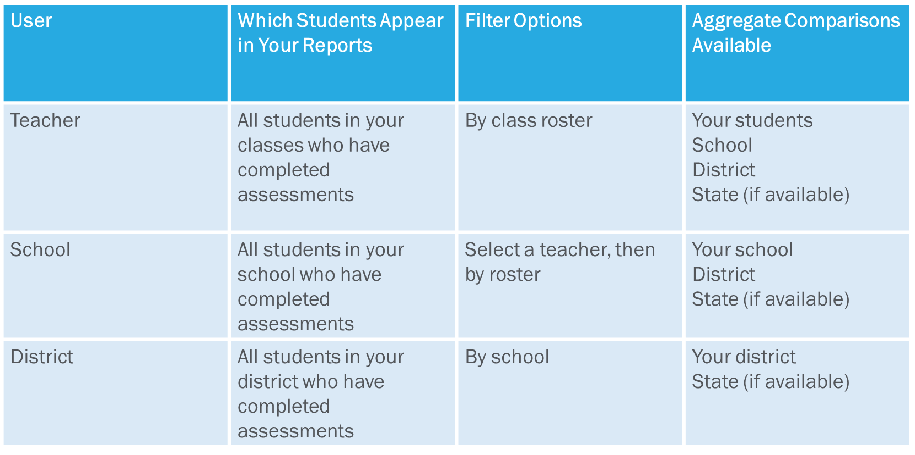
Understand Different User Roles
Notes:
Teachers, school-level users, and district-level users have access to different features and data in the Reporting System. This chart summarizes which students will appear in your reports, the filter options, and the aggregate comparisons available for each of the three roles.

Slide 5
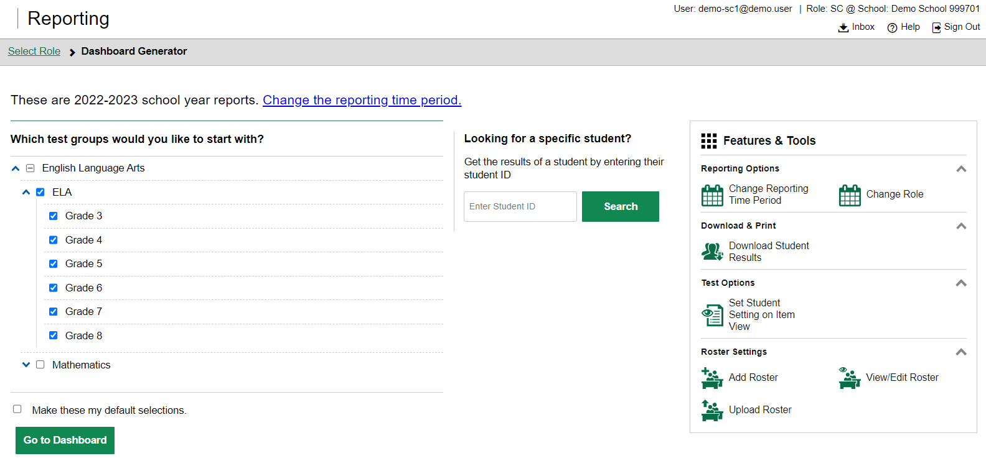
Dashboard Generator
1
2
3
Notes:
The Dashboard Generator page displays. This page is queued to display BEFORE the appearance of the dashboard so you can easily customize your results in order to view only the data that are most helpful to you.
The banner displays your username and your role. Underneath is the Inbox, a Help button, and a Sign Out button.
There are three prominent sections on the page. In section 1, you will find the test group selection section where you can check only the tests that apply to your needs and make those your default selections. In section 2, you can access an individual Student Portfolio report by entering a student ID number in the search box. In section 3, you see the Features & Tools menu where you can take some actions prior to viewing data on the dashboard.
To save your selections, mark the checkbox Make these my default selections. These selections will be set in the Dashboard Generator whenever you log in. You can change the defaults at any time.
Click Go to Dashboard.

Slide 6
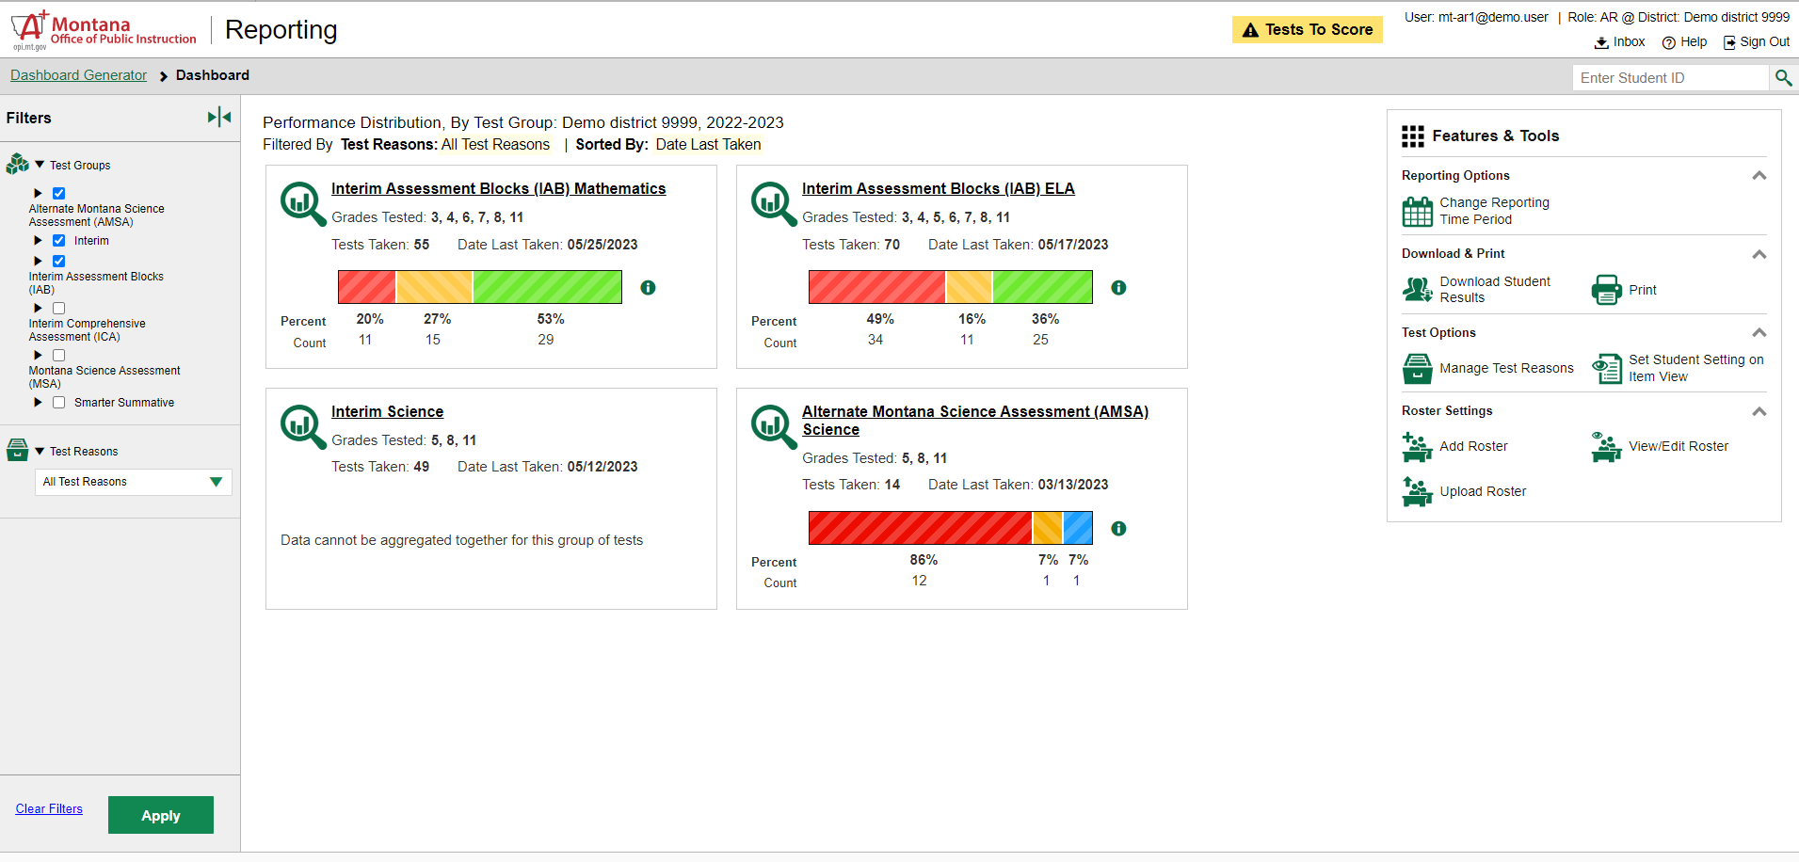
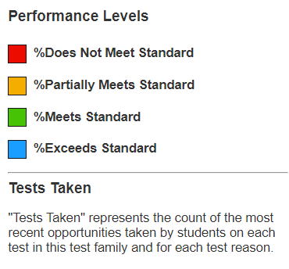
Dashboard—Test Group Cards
Notes:
The Dashboard appears after you select test groups. Test information and results are displayed for the students who are assigned to you based on your role. Teachers see all the tests their students have taken. School-level users see tests taken by all the students in the school. District-level users see the tests taken by all the students in the district.
A test group card displays for each test, by subject, along with the grades tested and the total tests taken. The cards are sorted from left to right, then top to bottom based on the date last taken. The performance distribution results display as a color-coded bar with the percent proficient and student count listed under each colored level. Click the green information button to display the performance levels. The data on the dashboard gives teachers, administrators, and principals a way to quickly compare how their students performed across different test groups.

Slide 7
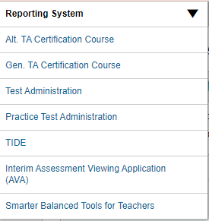
Dashboard—Filters Panel
Notes:
If you want to change the data you see, use the Filters panel to further customize your Dashboard. Make selections from the Test Groups options and/or the Test Reasons options. Test Reasons typically represent test administration seasons or opportunities. Selecting a test reason filters out results you do not need to see.
Click the green Apply button and your dashboard customizes according to your selections. Filter selections are highlighted in yellow in the table of results header. Clear the filters at any time by clicking the Clear Filters button and clicking Apply again..
In the upper-left corner of each page in Reporting is the “System Switcher.” You can move from the Reporting system directly into the TA Interface, the Data Entry Interface, TIDE, and other systems when you need to perform tasks in those systems. You don’t have to log out and log back in.
Click on the underlined name of a test group card or the green magnifying glass view button to advance to the Performance on Tests report.

Slide 8
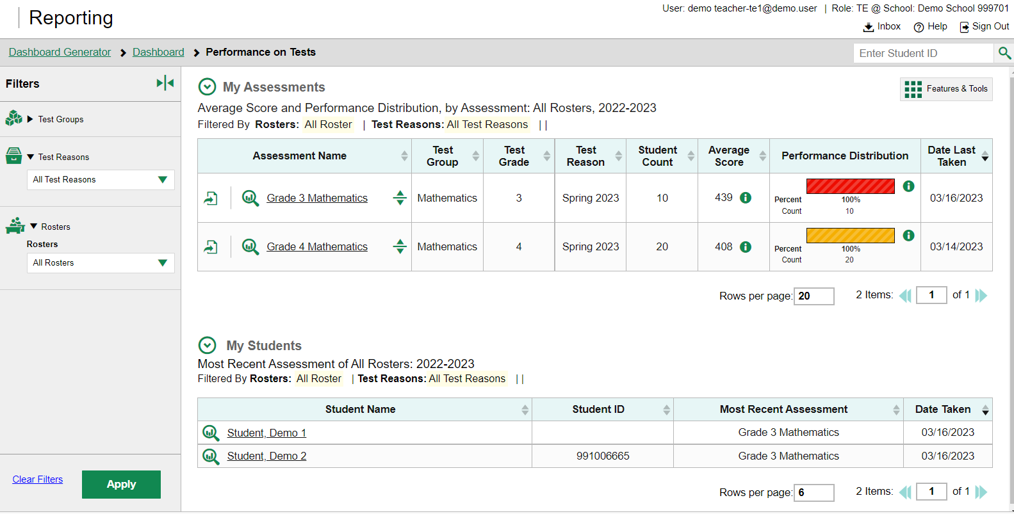
Performance on Tests Report for a Teacher—Two Tables
Notes:
When they select a test group card and leave the Dashboard, all users move to the Performance on Tests report. Here is the Performance on Tests report for a teacher who clicked on a summative mathematics test group card. The My Assessments table lists all the tests that the teacher’s students have taken, in order of date last taken.
The My Students table is a fast pass to the individual Student Portfolio report. This report is useful for teachers as they prepare for parent-teacher conferences where student performance across all tests is needed.
Teachers have a Rosters option in the Filters panel. They can select one of their rosters, click Apply, and the Performance on Tests report customizes to show results for only students on the selected roster.

Slide 9
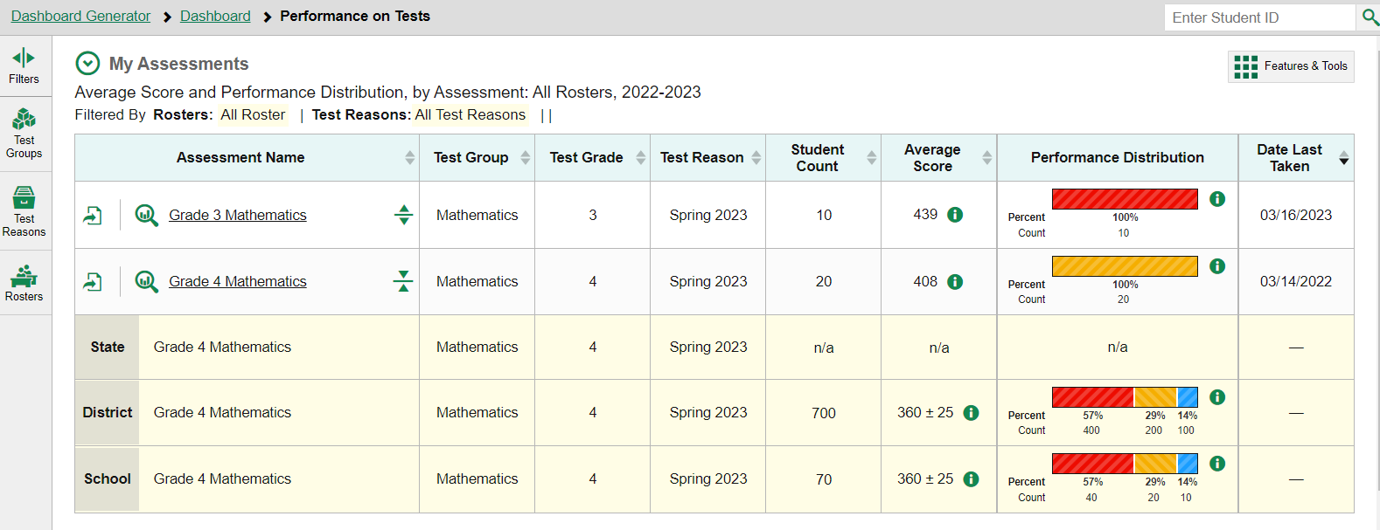
Performance on Tests Report for a Teacher—Aggregate Comparison Rows
1
Notes:
You can compare your results to aggregate state, district, and school data directly from the Performance on Tests report, depending on your user role. Simply click the expansion arrow to the right of the assessment name to display them. Shown here are the comparison rows a teacher will see. The aggregates are highlighted in yellow below the Assessment Name. Notice that an export button is included for each test in the table. Use it to generate a PDF, Excel, or CSV file of the results for that test.
Notice the path in the navigation trail at the top of the report page. Since this teacher has a single role, the Select Role breadcrumb does not display. The teacher has navigated from the Dashboard Generator to the Dashboard to the Performance on Tests report. You can use this trail to return to any previous page in Reporting.
Click on the underlined name of the report or the magnifying glass view button to the left of it to drill down into that test data.

Slide 10
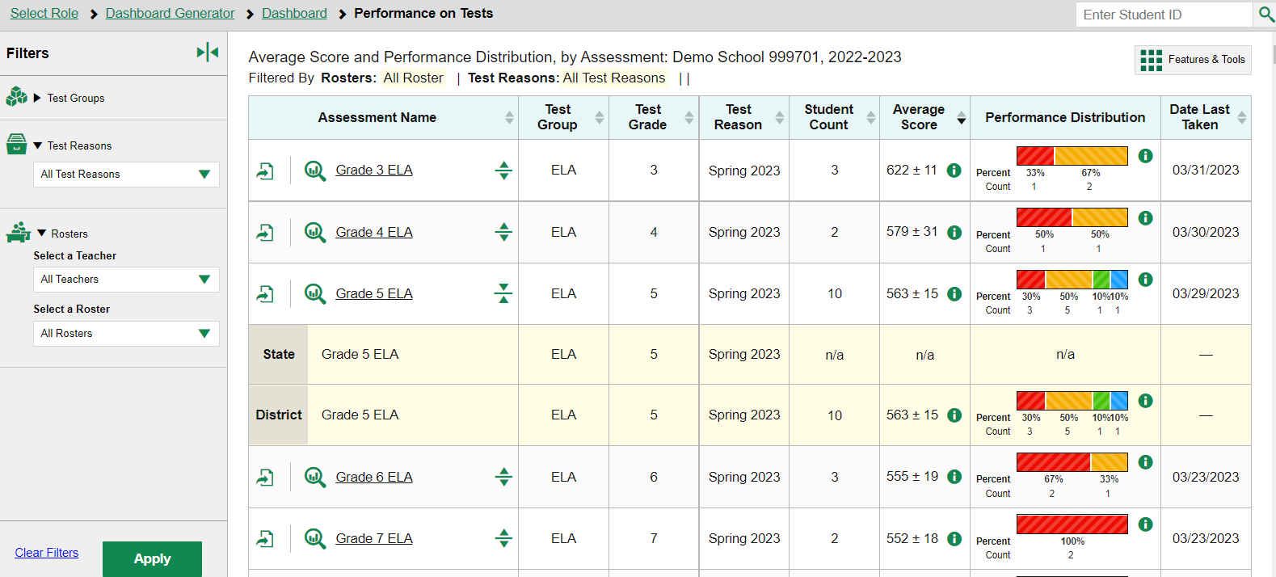
Performance on Tests Report for a School-Level User
Notes:
Here is the Performance on Tests report for a school-level user who selected the ELA test group card from the Dashboard. It lists all the ELA tests the students in the school have taken. Notice there is a Rosters option included in the Filters panel. Principals and other school-level users can select a teacher then select one of their rosters to narrow down the results in the report. The school user will see State and District aggregates in the yellow comparison rows.

Slide 11
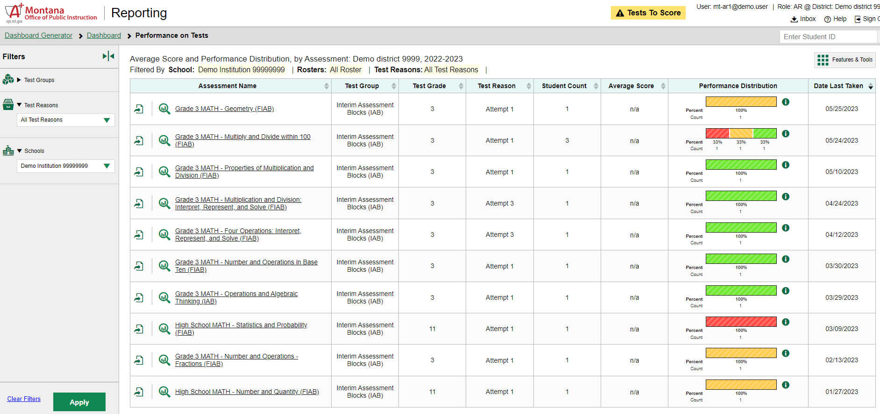
Performance on Tests Report for a District User
Notes:
Here is a Performance on Tests report as it displays for a district-level user who clicked on the Mathematics test group card on the Dashboard. The Filters panel now includes a Schools dropdown menu so that users can filter for one specific school. Select an Assessment Name from that column or click on the magnifying glass view button to see the District Performance on Tests report for that test.

Slide 12
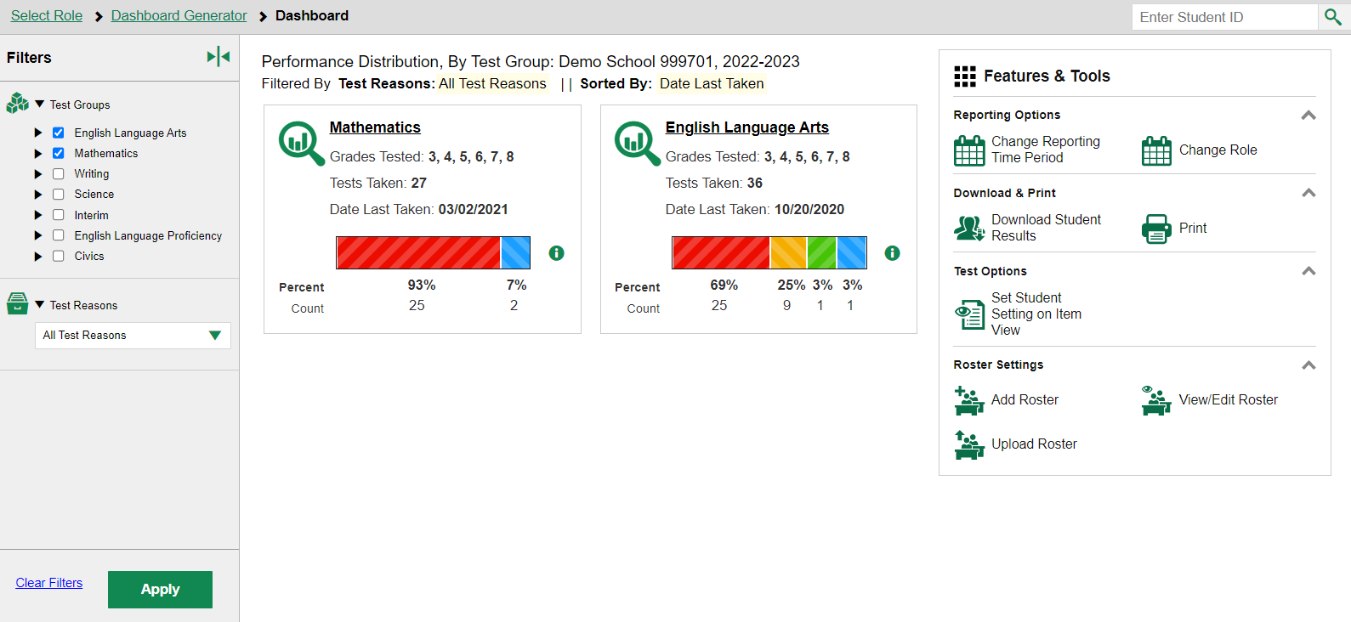
To Review
1
2
3
Notes:
To review the sequence of navigation: Reporting opens with the Dashboard Generator, followed by the customized Dashboard, then the Performance on Tests report. From there, you drill down into more specific test data. District users navigate to district reports, school-level users navigate to school reports, and teachers navigate to “My Students’” reports.

Slide 13
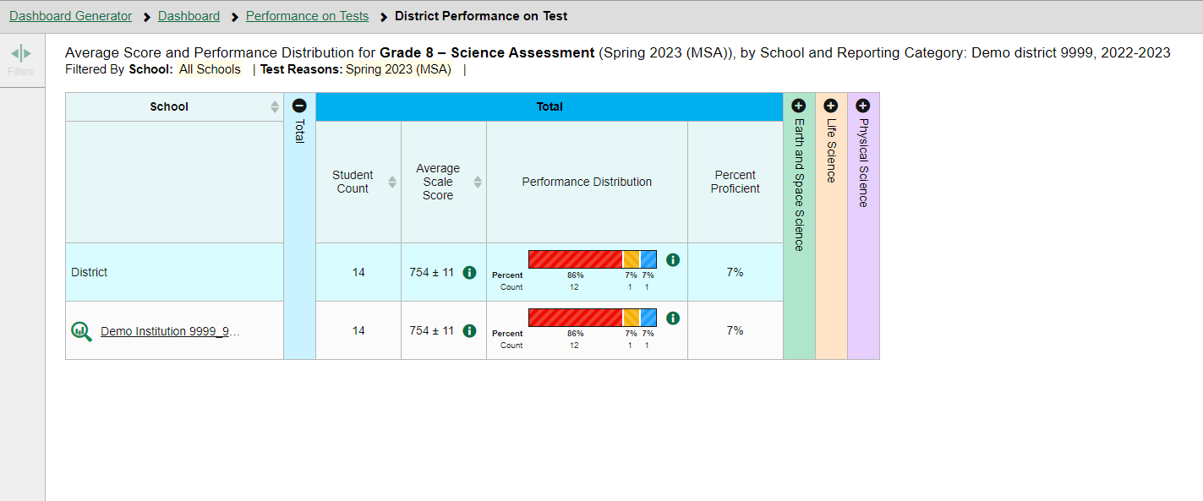
District Performance on Tests Report
Notes:
When district-level users select a test from the Performance on Tests report, the District Performance on Test report opens with a display of the schools in the district and the aggregate data for each school for the test group you selected. The State and District comparison rows now display at the top of the results table, along with Student Count, Average Scale Score, and the Performance Distribution indicator.
The performance measures used in a report depend on your state or district and the type of assessments administered. Two typical measures are scale score, or Average Scale Score and Performance Distribution as shown on this report for this summative Grade 3 Mathematics test. Interim tests typically report average scale scores while shorter benchmark tests report raw scores. Interim tests are covered in a separate section of this module.
The reporting categories, displayed in different-colored columns, are explained in the More Advanced portion of this module.
To navigate to school-level results, click the name of a school or the green magnifying glass view button.

Slide 14
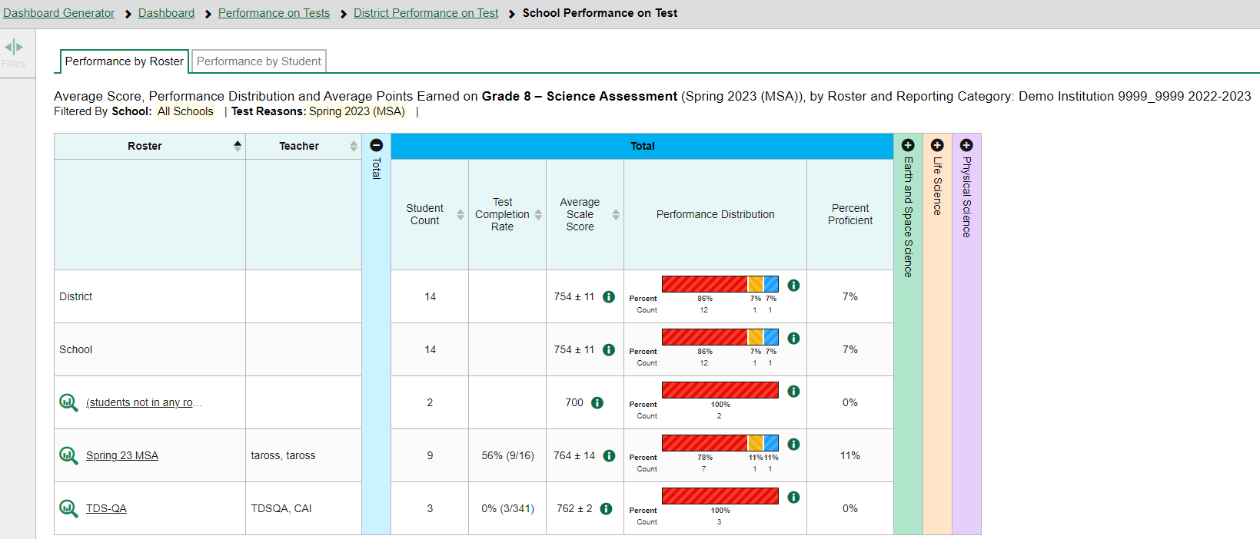
The My Students’ Performance on Test Report—by Roster
Notes:
In the School Performance on Test report, results are organized by Roster, by default. Two tabs, Performance by Roster and Performance by Student, appear at the top of the results table, allowing the school-level user to toggle between roster results or student results.
You may be able to check the Test Completion Rate for each roster in the school using this report, as well as Average Scale Score, Performance Distribution, and any other performance measures in use.

Slide 15
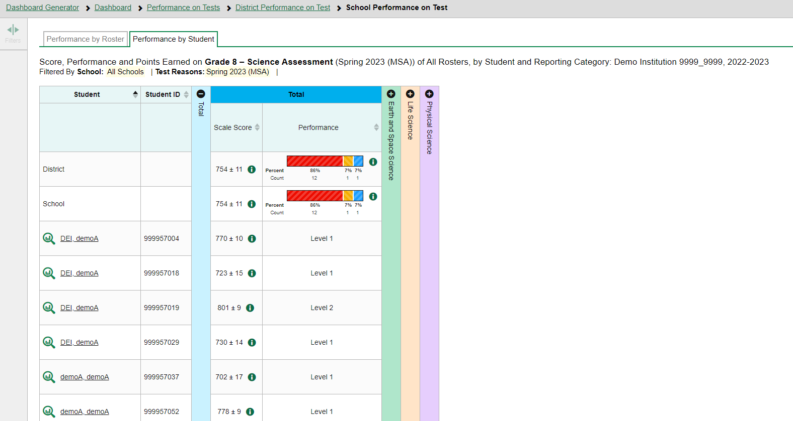
School Performance on Test Report—Student Tab
Notes:
Here is the same School Performance on Test report showing Performance by Student. There is one more drill down option at this point -- to isolate a student’s test results by clicking on the Student name or the magnifying glass view button to the left of it.

Slide 16
Student Performance on Test
Notes:
Here is the Student Performance on Test report showing a single student’s performance. Note that the student’s name is no longer underlined, nor is there a green magnifying glass view button next to it. This is the end of the navigation trail.

Slide 17
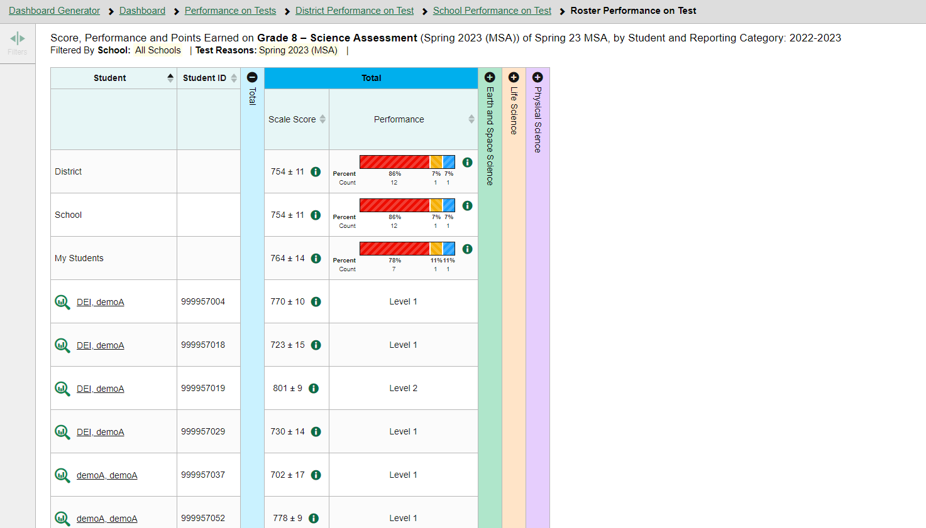
The My Students’ Performance on Test Report—by Roster
Notes:
This is a My Students’ Performance on Test report for a teacher who clicked on the Grade 3 Mathematics assessment from their Performance on Tests report. The My Students’ Performance on Test table lists the class rosters in the left column with the State, District, School, and My Students comparison rows above – to isolate a student’s test results by clicking on the Student name or the magnifying glass view button to the left of it.

Slide 18
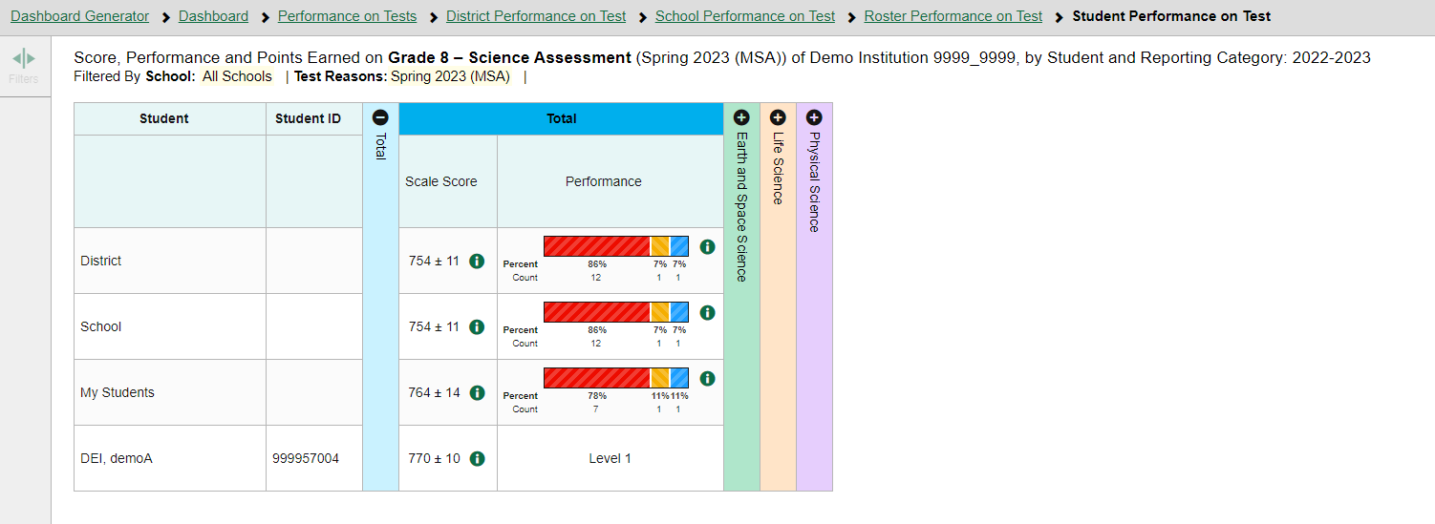
The My Students’ Performance on Test Report—Student Tab
Notes:
This Student Performance on Test report is the end of the navigation trail for a teacher. There is no magnifying glass view button next to the Student name, nor is it underlined.

Slide 19
Tests with Reporting Categories
Notes:
For tests with reporting category sections, you can compare the performance of your students in each area of the test. Click each vertical section bar to expand or collapse it. In this example, you can view the performance level for each student under the reporting categories for this Grade 8 Science test.

Slide 20
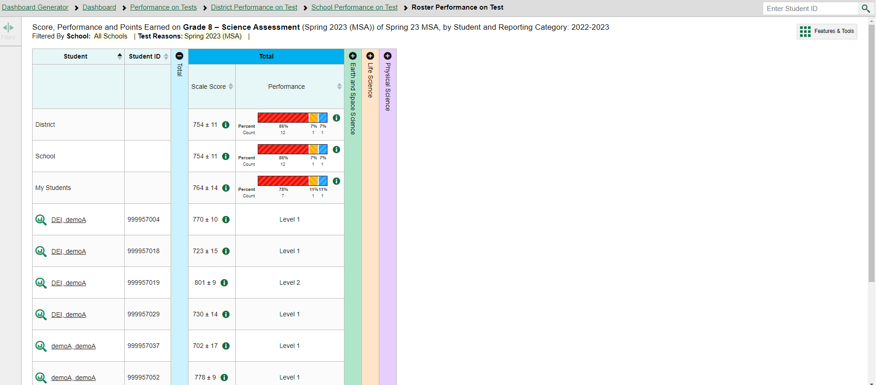
Access the Student Portfolio Report
Notes:
All users can access the standalone Student Portfolio report from any test report page. Copy and paste the student ID number into the search box and then click the search button, as shown in the upper-left image.
Teachers have a fast pass to this report from their My Students table on their Performance on Tests report page. Simply click the student’s name or the magnifying glass view button and the report displays.

Slide 21
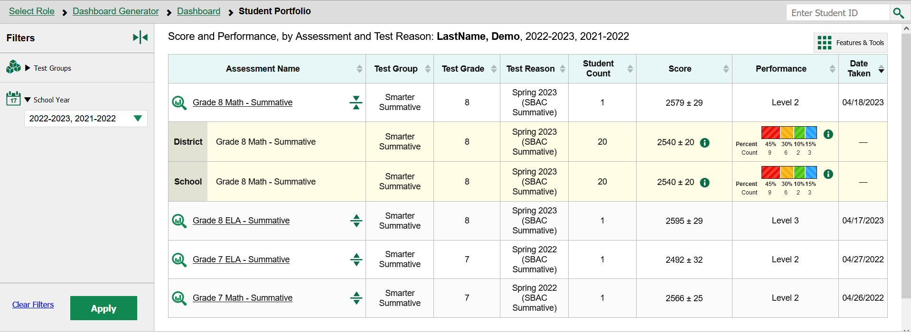
Ways to Use the Student Portfolio Report
5
2
4
1
3
6
Notes:
The Student Portfolio report lists all the tests the student has taken in the current school year.
This report is designed so that users can quickly:
Add tests from previous school years to get a complete list of all tests taken by the student.
Filter by Test Group to eliminate test groups you don’t need to see.
Compare a student’s results with state-, district-, school-, and/or teacher-level data using the expansion arrows to the right of each assessment name.
4. Sort results in any column with a set of sorting arrows in the header.
5. Generate and print an ISR or a Student Data File using the Features & Tools button.
And access specific test data directly from the report by clicking the Assessment Name or the magnifying glass button to the left of it.

Slide 22
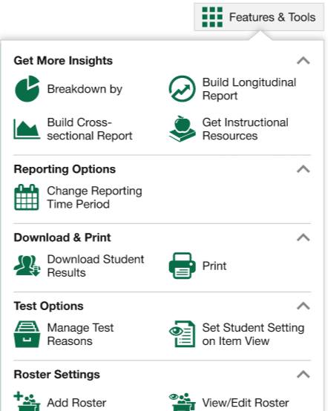
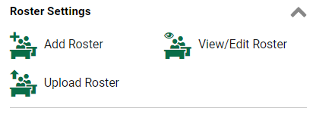
Download & Print Features
Two Types of Results
Individual Student Reports (ISRs)
The Student Data File
Notes:
The Features & Tools menu is available at the upper-right corner of every page in Reporting. The actions displayed here vary, depending on the type of assessment and the user’s role. This section covers how to print reports and how to download student results in the form of Individual Student Reports (ISRs) and the Student Data File.

Slide 23
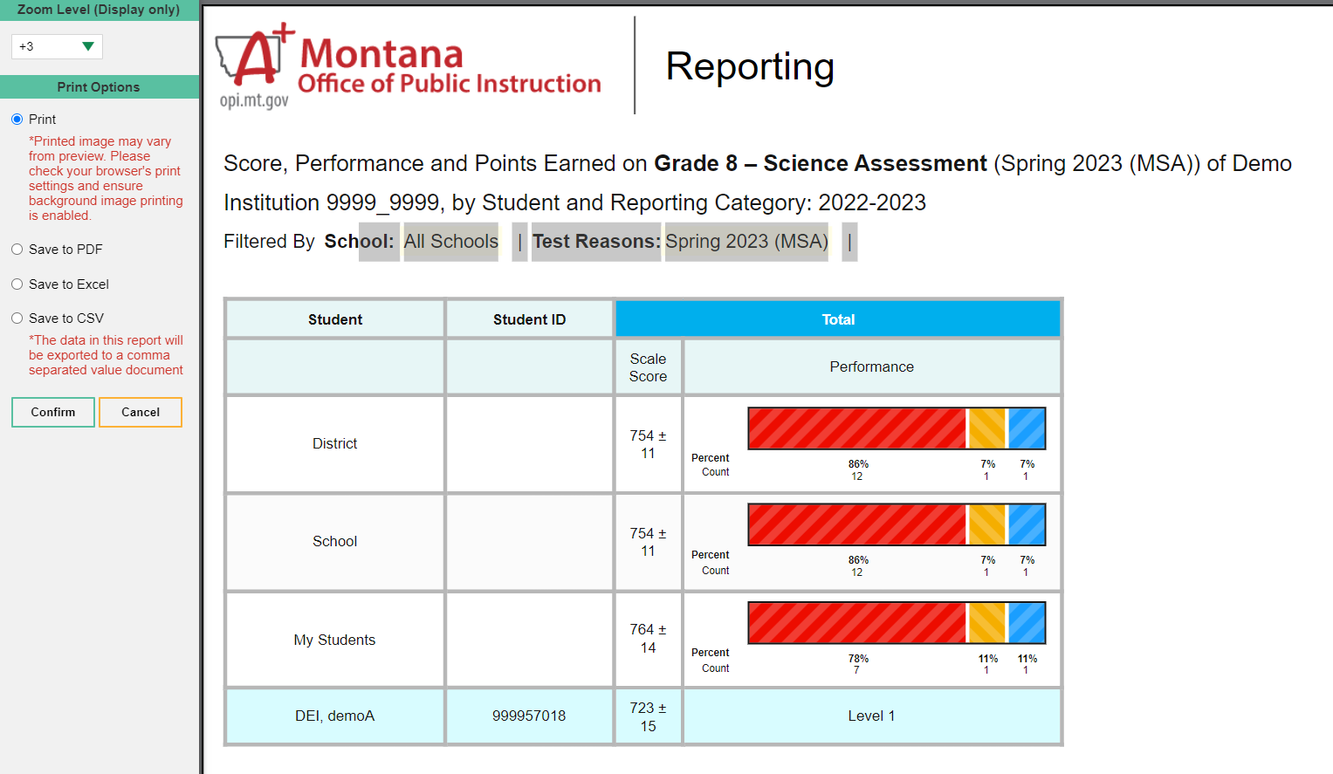
Print Anything You See on Your Screen
Notes:
You can order a print file from any page in Reporting except the Dashboard Generator. You are presented with Zoom Level and Print Options and a preview of what will print. Make your selections from the gray panel on the left side of the page and click Confirm. If you save to PDF, Excel, or CSV, the file is stored in your Inbox for 29 days. Here, you see a print preview of the My Students’ Performance on Test report for an Algebra 1 test.

Slide 24
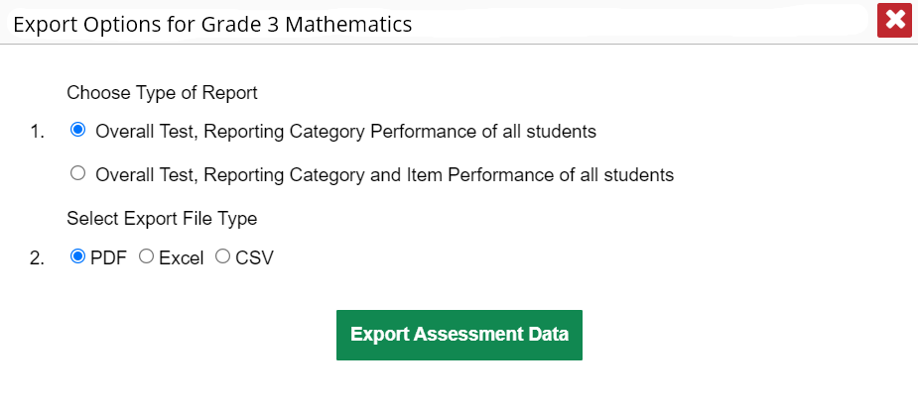
Export Options
Notes:
You can export data from any report where you see the export icon located to the left of the Assessment Name. Your export options will depend on the test report type. You may have the option of selecting summary reports including just the reporting category performance, or you may choose to export them with the item performance of all students included. Make your Export File Type selections and click Export Assessment Data.

Slide 25
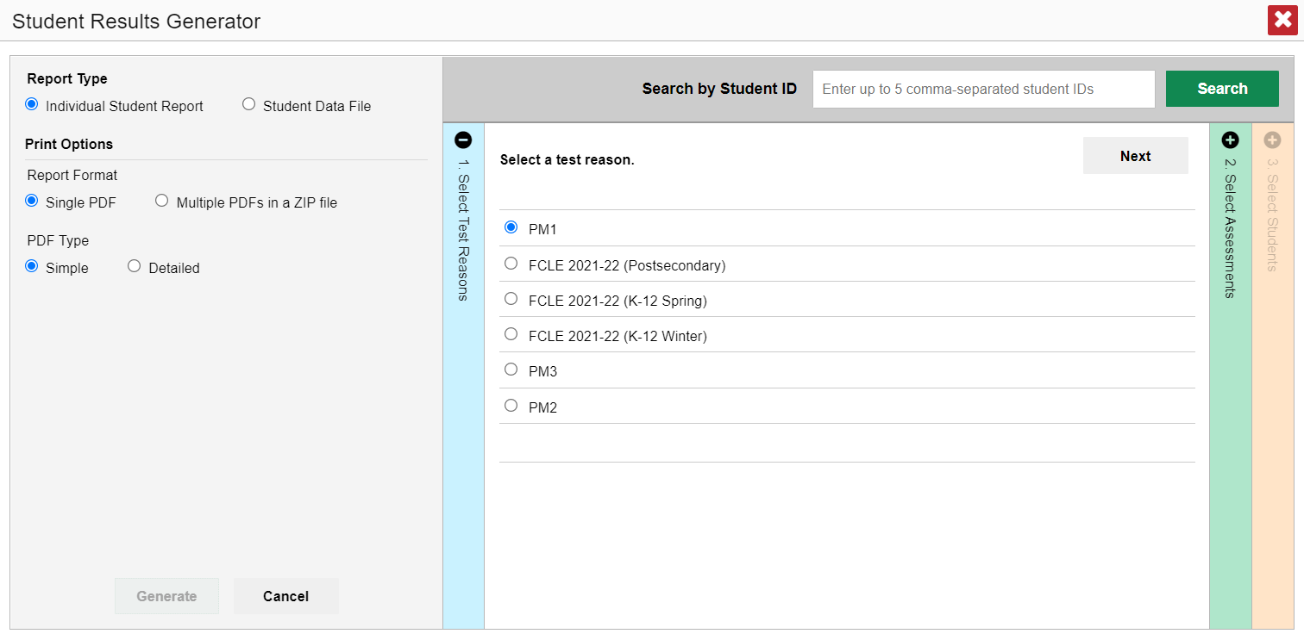
Build ISRs and Student Data Files/Test Reasons
1. Select a test reason.
Sample administration 1
Sample administration 2
Sample administration 3
Sample administration 4
Sample administration 5
Sample administration 6
Notes:
The Download Student Results button allows you to generate an Individual Student Report (ISR) or a Student Data File. An ISR is a PDF that displays test results for a single test opportunity taken by a student. It may consist of a single page or multiple pages. ISRs are useful for sharing performance information with students and their parents and guardians. A Student Data File is an Excel, CSV, or text file of the information used for analysis.
The Student Results Generator button is the “head and shoulders” icon located in the Features & Tools menu, under the Download & Print options. It is labelled Download Student Results. When you click it, the Student Results Generator pop-up window displays. Both reports, the ISR and the Student Data File, are typically built by completing three numbered and colored sections:
#1 Select Test Reasons
#2 Select Assessments
#3 Select Students.
In this section, we take you through the steps of generating an ISR. You construct the Student Data File in the same way, but your report will be in the form of an Excel, CSV, or text spreadsheet.
Here is the Student Results Generator window showing pre-populated or pre-selected options, although you can change those selections to match your needs. This slide shows the window for a teacher who is viewing the roster results for Grade 3 Mathematics, taken in Sample administration 1.
Test Reasons are typically test administration windows. They can also be categories, like Pre-test or Post-test, or a numbered opportunity. Select the test reason you need. You can only select one test reason.
Now, go to the other two sections and confirm or change the selections. You open and close each column by clicking the + or - symbols at the top of the columns, or you can click the Previous and Next buttons at the top of each open column.

Slide 26
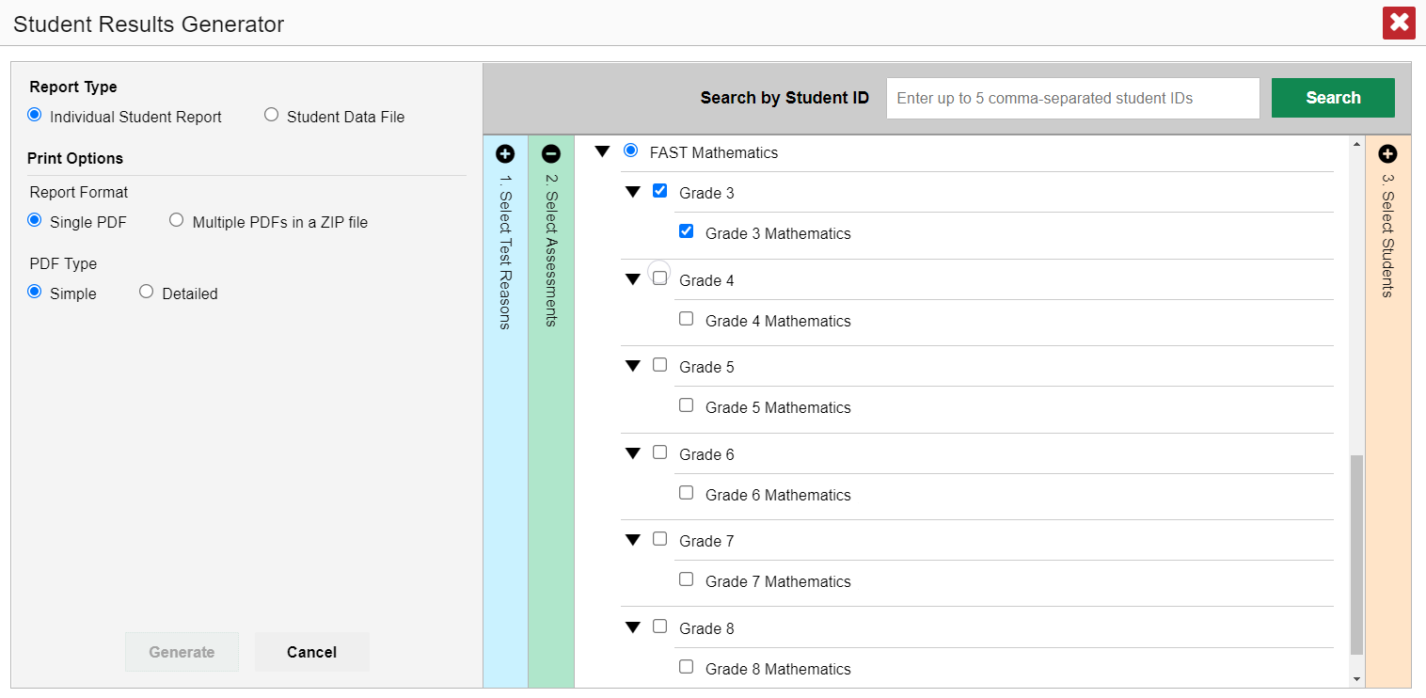
Select the Assessments
2. Select the Assessments
MATHEMATICS
Notes:
Column 2 lists assessments by subject and grade. Select individual assessments or subjects. When you are generating ISRs you can select multiple grades under ONE subject, but not multiple subjects.

Slide 27
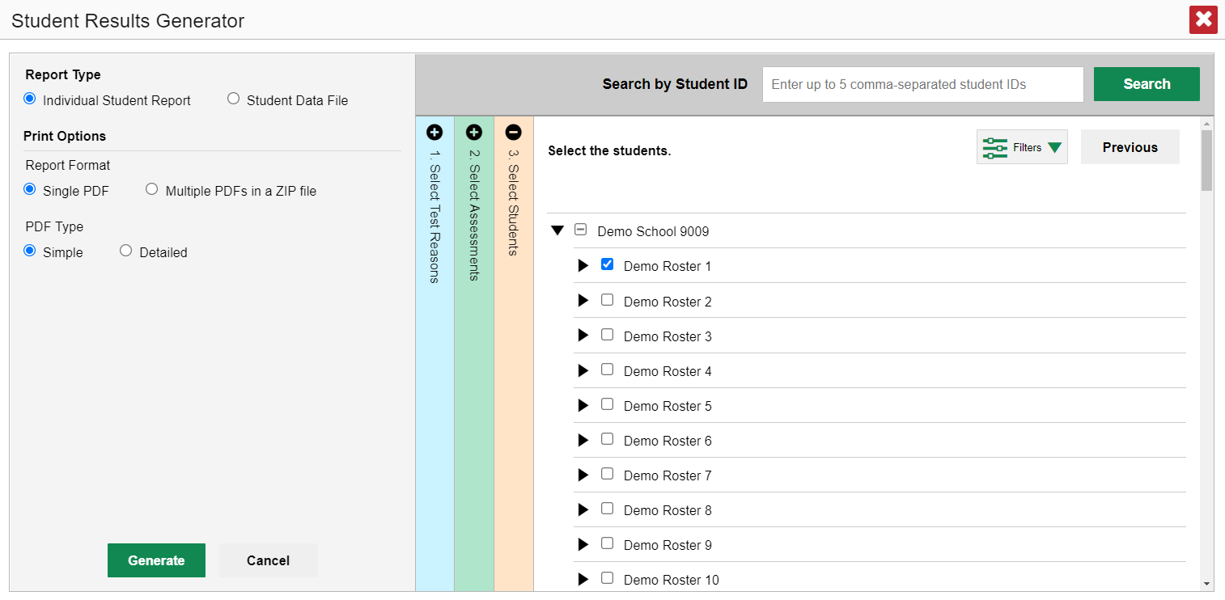
Select the Students
3. Select the students.
Notes:
Column 3 is labeled Select Students. The Select Students column displays the rosters in the Demo School. Each roster can be expanded to show the students on that roster by clicking on the arrow next to the roster name.
District assessment coordinators are limited to selecting students from up to THREE schools only.

Slide 28
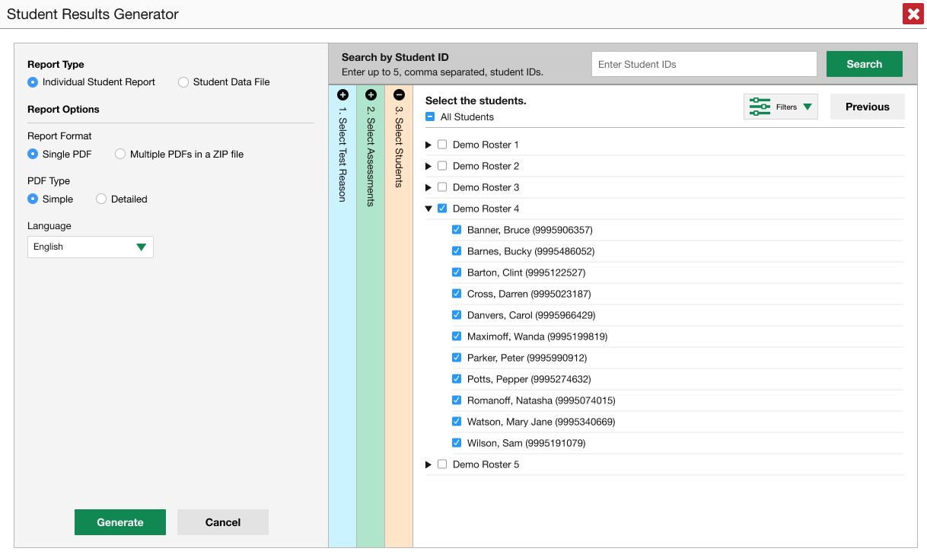
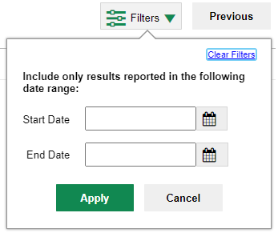
Another Customizing Option
4. Set Date Range
Notes:
Another customizing option is accessed via the Filters button which is in the Select Students section to the left of the Previous button. You can select a range of dates to be included in the ISR by using the calendar to enter a start date and an end date. Click Apply. After making your customizations, click the green Generate button and the ISR(s) will post to your Inbox.

Slide 29
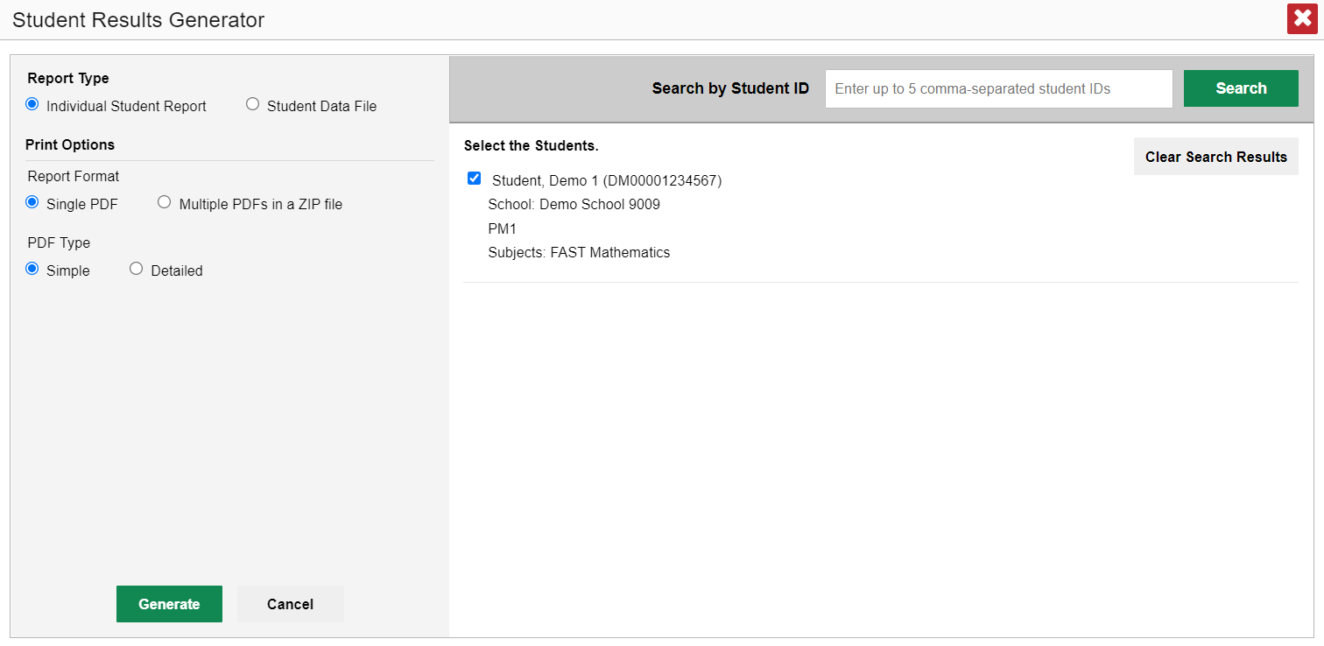
ISR from the Student Portfolio Report
Student, Demo 1 (DM00001234567)
School: Demo School 9009
Sample Administration 1
Subject: Mathematics
Notes:
If you click the Download Student Results button from the Student Portfolio Report, the data will load pre-populated, as shown here, without the three colored panels. You see the student’s name and ID number, the school, the test reasons which display as test administrations of the current school year, and the subject, Mathematics. You can clear the Student Portfolio selection by clicking Clear Search Results. That removes the selected student and takes you to the three panels you can select from, with nothing pre-selected.
When you click the green Generate button, the report will post to your Inbox.
If you need to print just a few more student’s ISRs, you can enter up to five, comma-separated student IDs in the Search by Student ID box, and the same pre-populated template will display, allowing you to generate the ISRs for all those students’ tests.

Slide 30
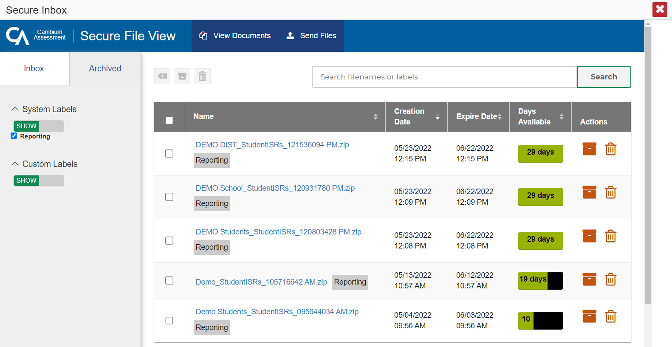
Secure Inbox
05/23/2023
12:15 PM
06/22/2023
12:15 PM
05/23/2023
12:10 PM
06/22/2023
12:10 PM
05/22/2023
12:15 PM
06/21/2023
12:15 PM
05/21/2023
12:10 PM
06/20/2023
12:10 PM
05/20/2023
12:15 PM
06/19/2023
12:15 PM
Notes:
Here is a sample Inbox showing multiple ISR postings. You can archive or delete a file at any time by using the buttons under the Actions column in the results table. Click on the name of a file to download it to your computer.
Files are automatically deleted after 29 days in both the Inbox and the Archived boxes.

Slide 31
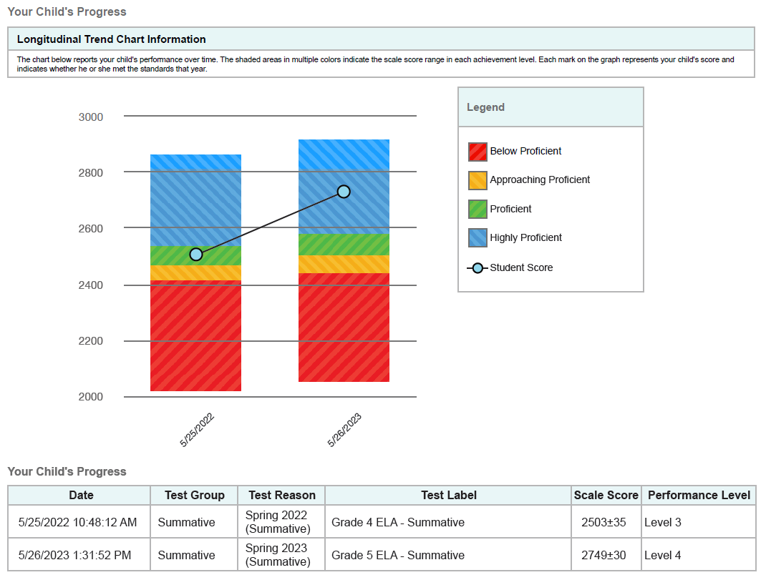
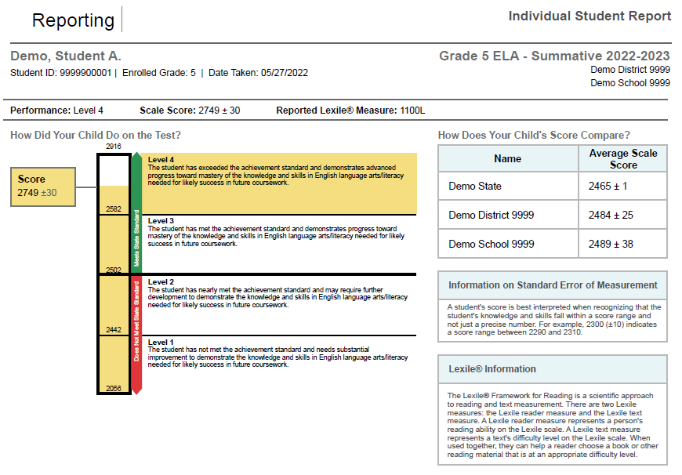
Sample ISR
Simple ISR
Detailed ISR
Notes:
Here is a sample ISR. You can order a simple report or the more detailed report. The detailed report may include a longitudinal trend chart section, like the one shown here. You can see the student’s progress over time as the three tests results display as performance level and scale score.

Slide 32
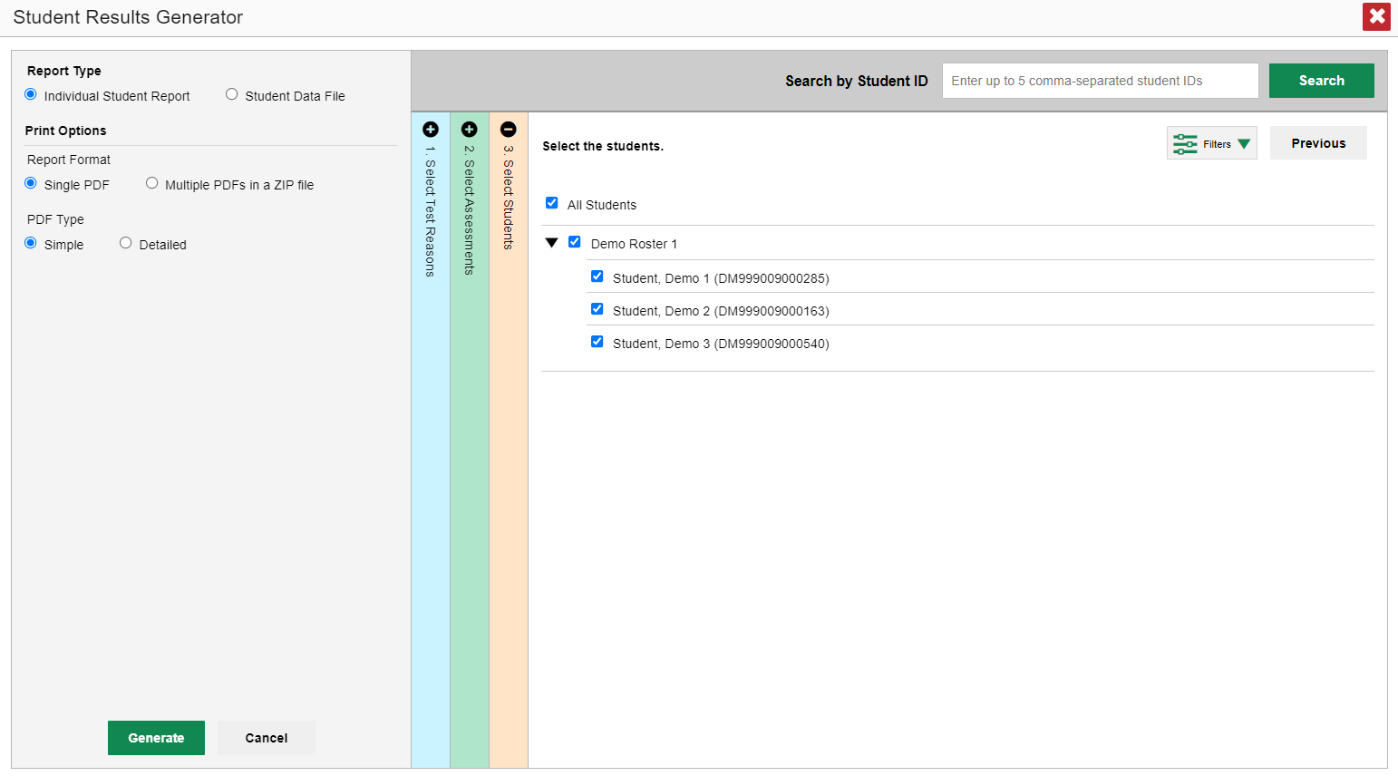
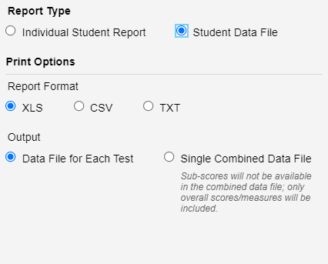
Generate a Student Data File
Student Data File—
Excel Worksheet
Notes:
A Student Data File is a user report of performance data, in Excel, CSV, or text format. Files of this nature allow the user to employ the workbook features of a spreadsheet application to organize and sort the data. The generation process for a Student Data File is the same one used for the ISR with different print options, with fewer restrictions. You can select tests in as many subjects as you want.
Customize the Student Data File using the same three selection columns and the Filters button. Choose your desired export format and click the green Generate button. The Student Data File displays in the user’s Inbox. A sample file is shown here.

Slide 33
Generating ISRs and Student Data Files
ISRs
Student Data Files
One test reason
A single subject; multiple grades
Up to 3 schools for district-level users
One test reason
Multiple subjects; multiple grades
Multiple schools in a district
Data file for each test or combined data file
Notes:
Here is a review of the parameters of the options for each type of file, ISRs and Student Data Files.

Slide 34
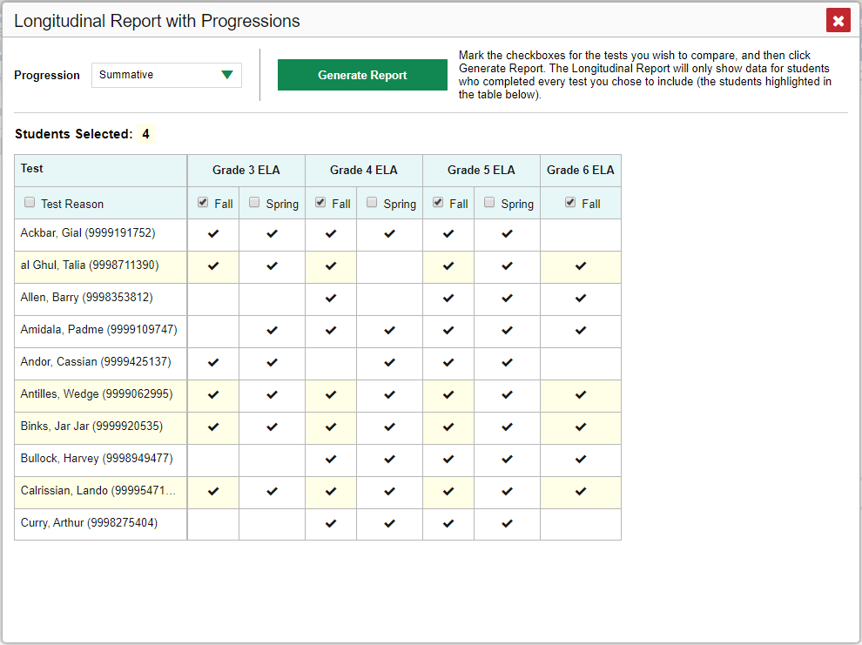
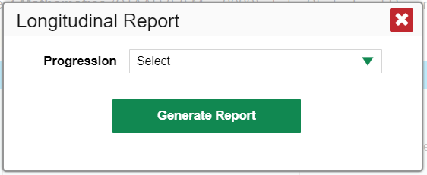
Longitudinal Report
Drop-down options are:
Summatives
Interims
Both
Only students highlighted in yellow will appear on the Longitudinal Report.
Notes:
When multiple tests are related and have been linked in the system, a Build Longitudinal Report button will display in the Features & Tools menu. Depending on your role, the test types, and the number of students in the report, it may display a report options page rather than the Longitudinal Report itself. If you are viewing a Longitudinal Report for which both Interims and Summatives are available, the Progression drop-down list appears, allowing you to select Summatives only, Interims only, or a combination of both test types.
Click the green drop-down arrow to select summative tests only, interim tests only, or a combination of both. Then click the green Generate Report button.
Teachers viewing a longitudinal report for multiple students are presented with a Longitudinal Report with Progression pop-up window. The Progression drop-down menu is located at the top of the window followed by a table of their students and the related tests. Each test appears in its own column, with sub-columns below for each test reason (categories of tests, or for a summative, a testing window).
The cells in the columns display checkmarks to indicate which students completed which test and test reason combinations. The students highlighted in yellow have completed all of the related tests and will appear on the longitudinal report unless you change the tests you want included in the report.
Mark the checkbox for each test/test reason combination you wish to include in the report. Mark the Test Reason checkbox on the left to include all test reasons or clear it to remove all. Click the green Generate Report button at the top of the window to view the Longitudinal Report

Slide 35
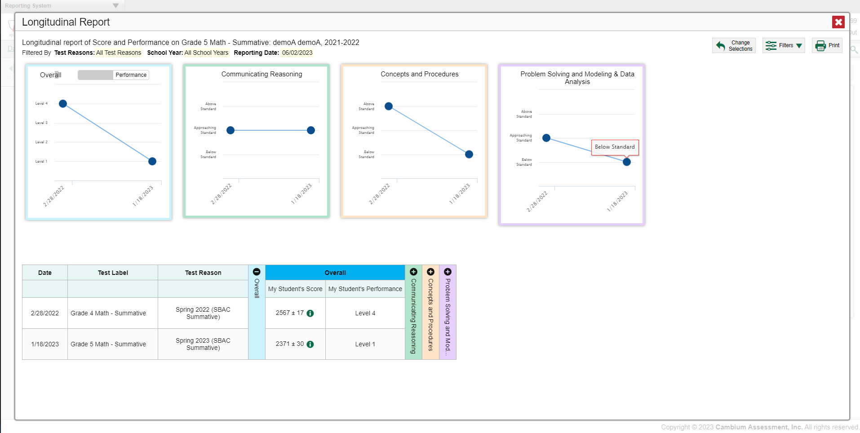
Longitudinal Report for Multiple Students, Multiple Test Types, & Reporting Categories
Notes:
Here is a sample Longitudinal Report with Progressions example for multiple students who took multiple related test types (Grade 10 and Grade 11 Interim ELA and Summative ELA), displaying with reporting categories. Score data are plotted along a line. A symbol appears on each data point. When multiple test types are present, refer to the legend immediately below the graphs to find out which symbols correspond to which types of tests. You can click the test type toggles in the legend to hide or show data for each one. To help you distinguish between test types, the interim test is identified with a blue circle and the summative test is identified with a blue diamond.
Performance-level data are shown either the same way or, for multiple students, in performance distribution bars, similar to the reporting category graphs which allow you to see, at a glance, how students are improving or declining in each area of the test. Hover over the data points in a line graph or the sections in a bar to get more information.
Alternatively, in the table at the bottom of the report, the data are replicated, with expandable columns for the reporting categories.

Slide 36
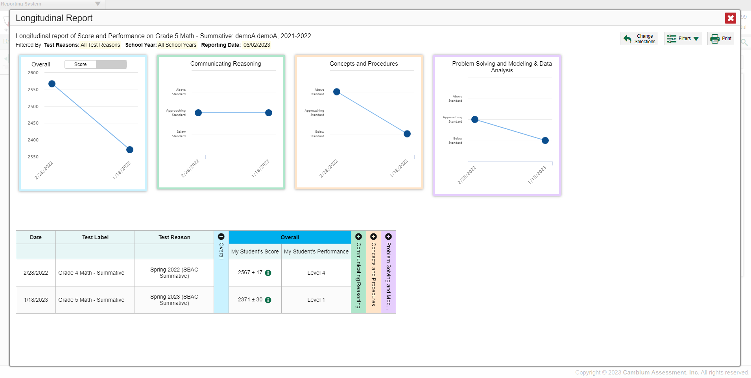
The Longitudinal Report—Scores Over Time
Notes:
Here is a sample Longitudinal Report for a student who took the Grade 3 Mathematics test on two opportunities in the spring test administration.
The graph in the upper-left corner of the report shows the scores for both opportunities. If you hover over the point, you can see the score displayed for each administration of the test. The first score was 1276, and the second score was 1475. The information in the graph is mirrored in the table below.
Toggle the switch at the top of the graph to see the results by Performance Level.

Slide 37
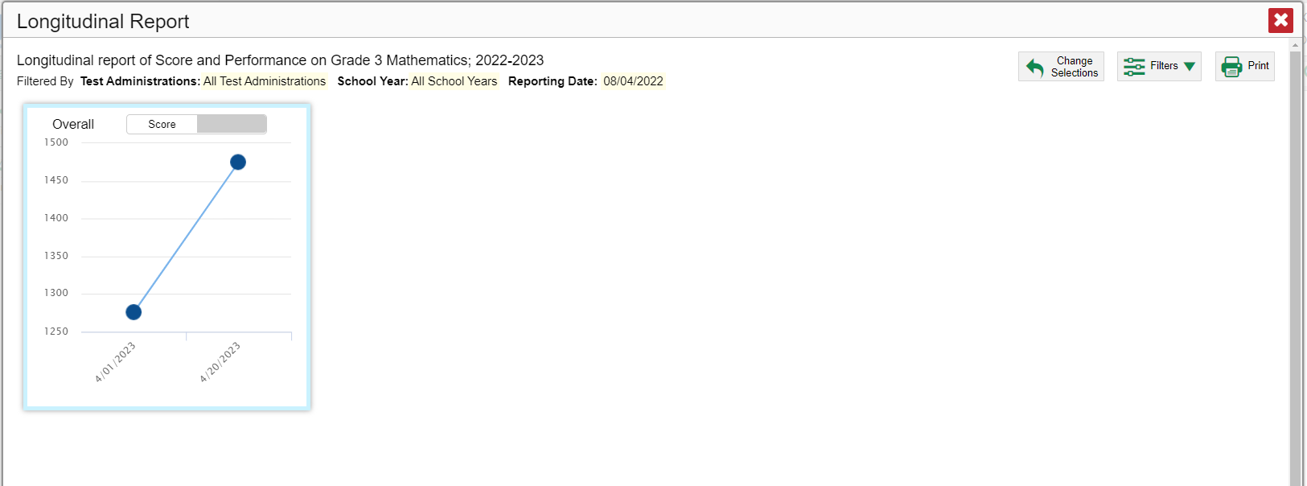
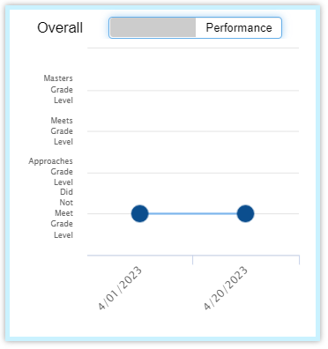
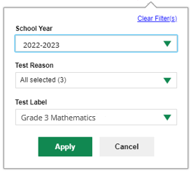
The Longitudinal Report—Performance Over Time
School Year: By default, data are shown for all years. Selecting a date, such as “2020,” will filter the results for the 2020—2021 school year results.
Test Reason: Most helpful for numerous interim and benchmark tests that can be screened by category, omitting those you do not need to see. Test reasons for summative tests are determined by administration date, typically the end of the school year or the course.
Test Label: Deselect the names of the tests you don’t need to see.
Date | Assessment Name | Test Administration | Overall | Overall
 |  |  |  | Score | Performance
4/01/2023 | Grade 3 Mathematics | Spring 2023 Opportunity 1 |  | 1276 | Did Not Meet Grade Level
4/20/2023 | Grade 3 Mathematics | Spring 2023 Opportunity 2 |  | 1475 | Did Not Meet Grade Level
Notes:
Now, on the graph, you see that the student remained in the Did Not Meet Grade Level performance measure over time.
You may want to filter a Longitudinal Report in order to focus on some test opportunities and not others.
Note that filtering tests may affect the set of students whose data are included in the report.
Open the filter menu at the upper-right corner and select the filter options you prefer from the drop-down lists.
You may want to filter by a particular school year or years. By default, Longitudinal Reports show data for all years. Longitudinal Reports can show student performance from a time when the students were not yet associated with you. For example, if you are a seventh-grade teacher, you can use these reports to view your current students’ performance on last year’s sixth-grade tests.
If the report includes interim assessments, you may wish to filter by a test reason (a category of test), which means excluding all other test reasons from the data. For example, you may want to narrow the report down to show only tests taken in the spring. For summative assessments, test reasons are the same as testing windows and are not useful.
Finally, you may find that certain individual tests are less relevant than others. In that case, you can use the Test Label options to deselect the names of the tests you don’t want to see.
Click Apply.

Slide 38
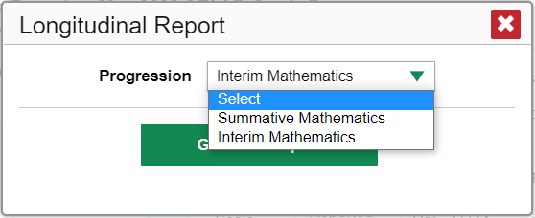
The Longitudinal Report—Progressions
Date | Assessment Name | Test Administration | Overall | Overall
 |  |  |  | Score | Performance
4/01/2023 | Grade 3 Mathematics | Spring 2023 Opportunity 1 |  | 1276 | Did Not Meet Grade Level
4/20/2023 | Grade 3 Mathematics | Spring 2023 Opportunity 2 |  | 1475 | Did Not Meet Grade Level
Notes:
If you generated the report using the report options page, a Change Selections button displays in the upper-right corner of the report window. You can use it to change your selection of test types and, if you are teacher viewing multiple students, your selection of tests and test reasons, as well.

Slide 39
Longitudinal Reports—Ways to Customize
Results from current and previous school years
Filter options: school year, test reason, test label
INDIVIDUAL REPORTS
GROUP REPORTS
Multiple instances of the same test (interims and benchmarks)
Related tests (typically related by standard and determined by school/district administration)
Students who completed the same test multiple times (interims and benchmarks)
Students who completed related tests
Notes:
To review, you can set up your Longitudinal Reports using results from current and previous school years, including data for your current and former students. Three filter options (school year, test reason, and test label) allow you to drill down into a Longitudinal Report to access specific data relevant to your needs.

Slide 40
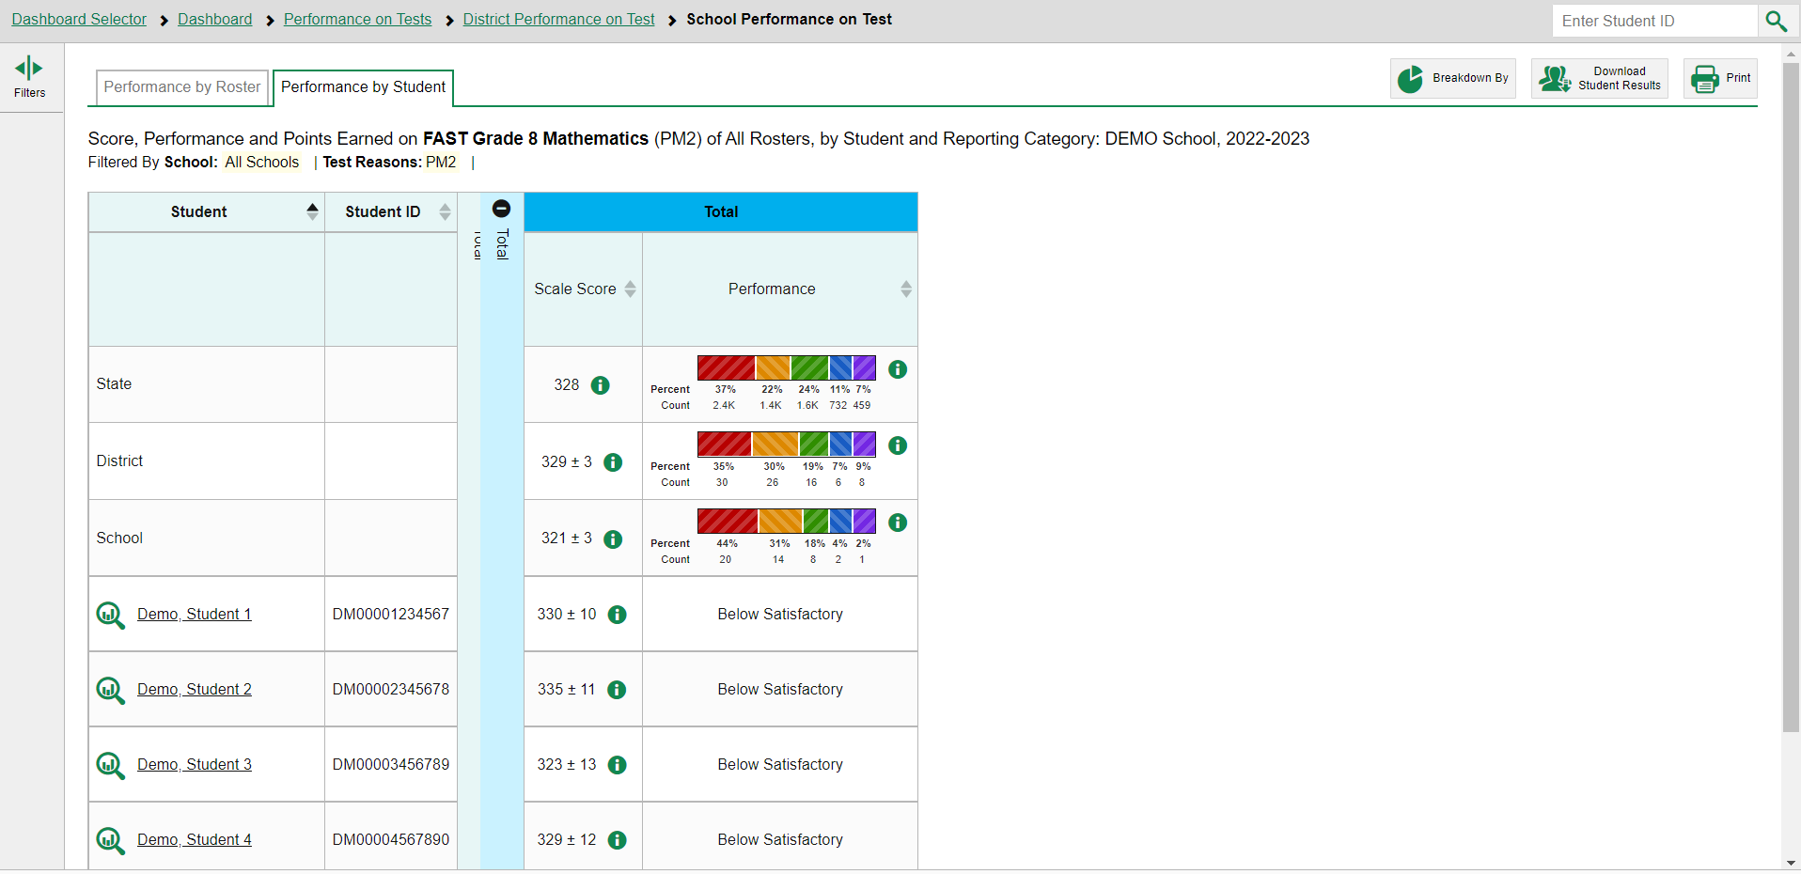
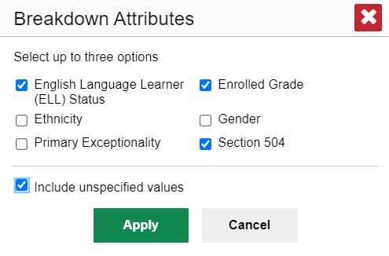
How to Build a Demographic Breakdown Report
Notes:
There is a tool that allows users to break down data by demographic sub-group. You can create a breakdown report from any page in Reporting that displays data for multiple students. Open the Features & Tools menu and click the Breakdown by button. A Breakdown Attributes window opens, displaying the options available to you.
For example, here, you see a School Performance on Test report for the Grade 8 Mathematics test. You can build a report for a specific group of students based on any three attributes listed in the Breakdown Attributes window.
For a sample report, the English Language Learner (ELL) Status, Enrolled Grade, and Section 504 options have been selected. A checkbox is displayed next to the term, “Include unspecified values”. This option, when selected, will include any of the user’s students with no demographic information assigned to them in TIDE. Click Apply. The customized report displays, as shown on the next slide.

Slide 41
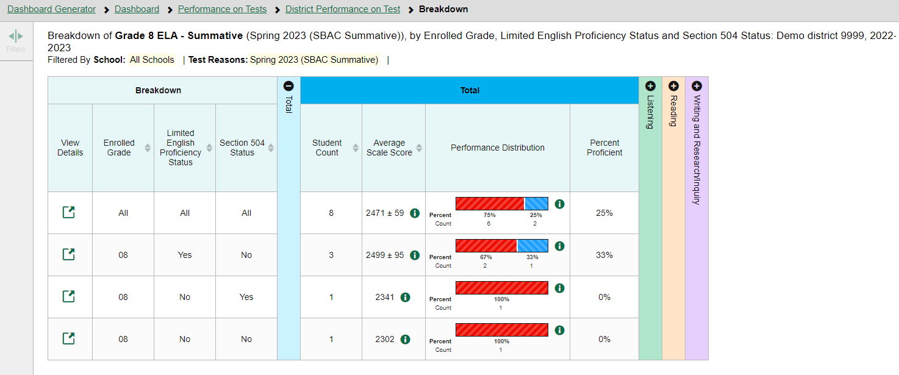
Demographic Breakdown Report
Notes:
The Breakdown page is organized according to the combinations selected. A row appears for each possible sub-group combination. The number of rows in the table will depend on how the students fall into the demographic categories.
For example, here you see a row for ALL the students, followed by some possible combinations. If a combination does not appear in the table, it means none of the students fall into that sub-group. Notice that the table header has updated to reflect the chosen attributes. You see from this breakdown report that there are 45 students who are divided into four sub-groups. You can sort the sub-groups in a few different ways -- by ELL Status, Enrolled Grade, and Section 504. To look closer into a specific sub-group, click the View Details button in that row.
Note: Enrolled Grade includes students in ALL grades who have taken this Grade 8 Mathematics test. Here you can see that a group of 19 7th graders took the test. None of them were ELL status or Section 504.

Slide 42
View Details Window/Breakdown Report
Notes:
A Breakdown window opens, displaying detailed results for that sub-group. A row of drop-down menu buttons appears above the table, displaying the attributes of the group you chose. To quickly transition to another demographic sub-group for the same test, you can apply the breakdown menu options that display above the table of results. Select an attribute you want from the drop-down menus and click Apply. The new sub-group will display.

Slide 43
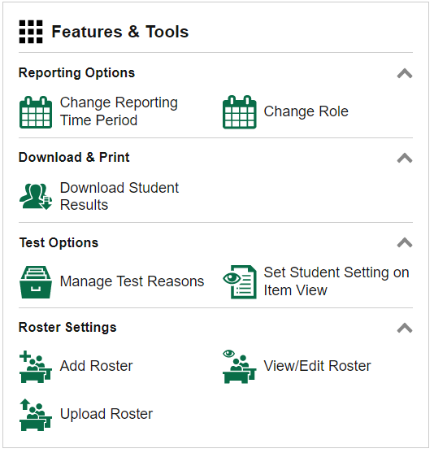
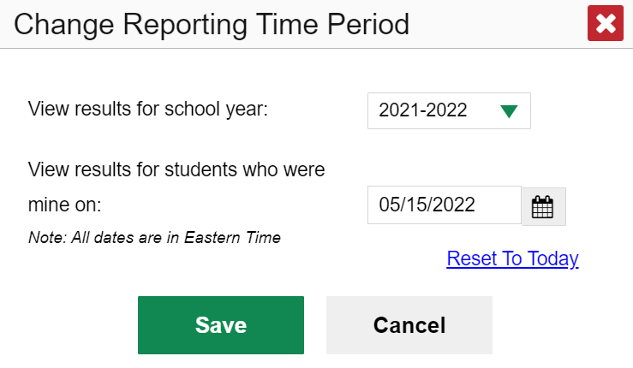
Change Reporting Time Period
Notes:
The Change Reporting Time Period option under Features & Tools allows you to view test results from a previous point in time, for your current students and/or for your former students.
When you want to view previous test results for your current students, select the school year from the drop-down menu in the schoolyear field. Leave the calendar tool set to the current date.
When you want to view test results from students you had in the past, select a school year from the menu in the schoolyear field AND use the calendar tool to set a date on which you know these former students were assigned to you. For example, a day in the month of May of that school year, after testing has begun.
When you click Save for either of the two options, your reports will reflect data according to those settings. When you log out of the system, the reporting time period defaults back to the current school year.

Slide 44
How Can I Get More Information?
You can contact the Help Desk for assistance with any technical issues you encounter.
When contacting the Help Desk, please be ready to provide the following:
Any error messages that are appearing (including codes)
Your operating system and browser information
Your network configuration information
Your contact information for follow-up by phone or email
Any other relevant information, such as test names or content areas, student IDs, session IDs, and search criteria
For test administration or policy issues, please contact your District Test Coordinator.
You can find more announcements on your assessment portal.
Notes:
We hope this module has given you a solid, basic understanding of the features and functions of the Reporting system. Watch for future announcements on your assessment portal page. A Reporting System User Guide is posted there. You can also call or email the Help Desk with your questions.

Slide 45
Thank You!
Further Information: Reporting System User Guide for Summative and Interim Assessments
https://mt.portal.cambiumast.com/
1-877-365-7915
mthelpdesk@cambiumassessment.com
Hours: M-F 6:00 a.m. – 6:00 p.m. MST
Notes:
Thank you for taking the time to view this training module. For detailed information, consult your Reporting System User Guide for Summative and Interim Assessments, located on your state portal, or contact your Help Desk.

